Slide 1
Project 2 -Competitive Landscaping
June 2021 - IronHack
Felipe Ávila /Guilherme Ribeiro Torres Pereira/Lucie Fleury

Slide 2

Switchup rankings Methodology
SwitchUp's rankings are based on over 20,000 reviews from verified students and alumni, across over 500 bootcamps in operation.
Rankings are ordered by review score.
If bootcamps have the same review score, bootcamps with more reviews are ranked higher to break the tie.
The order of the ranking is based on data at the time of publishing.
Notes:
G

Slide 3
About the data and the database
The database has been designed after analysis of the data that was scrapped from the Switchup website
offers alumni comments and ratings for coding schools throughout the world with info (type of class, FT vs PT, Online, Price, duration, job support)
The database was build to answer queries about schools’ campuses (location), schools’ ratings and classes (comments).
Informations that were taken out : alumni’s year of graduation, comment’s tagline, ...
Cleaning : Country codes, tags, images, Url
Notes:
L

Slide 4
Business Questions
Does the amount of campus have to do with the user rating?
Does country have to do with the amount of reviews?
Does online-course influence the rating?
Notes:
L

Slide 5
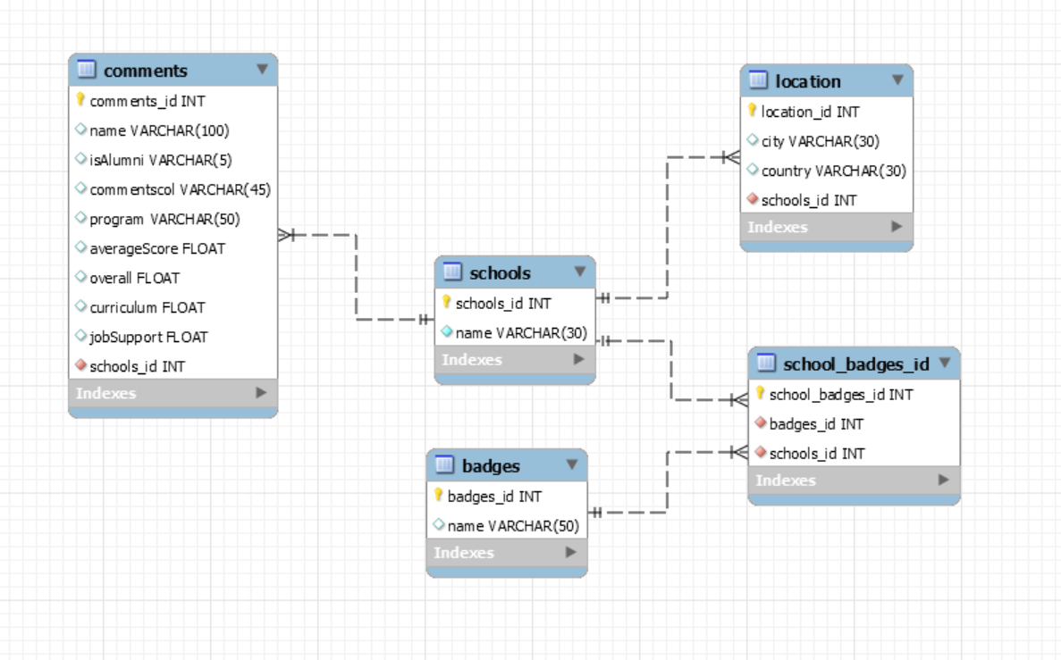
Schema of the Database
Notes:
F

Slide 6
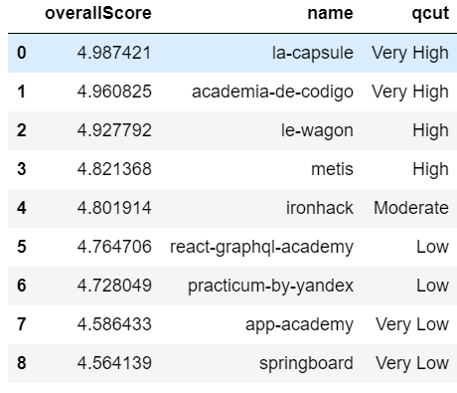
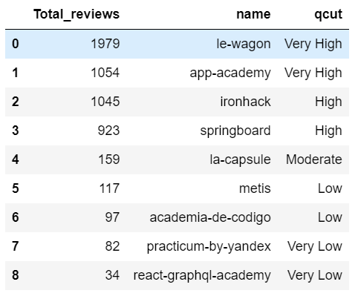
Analysis -qcut overall scores and reviews
Notes:
F

Slide 7
Analysis
Name | Campus Count | Overall Score | overall qcut
le-wagon | 46 | 4.92 | high
ironhack | 10 | 4.8 | moderate
metis | 6 | 4.82 | high
react-graphql-academy | 6 | 4.76 | low
academia-de-codigo | 4 | 4.96 | very high
la-capsule | 3 | 4.99 | very high
app-academy | 3 | 4.59 | very low
practicum-by-yandex | 1 | 4.73 | low
springboard | 1 | 4.56 | very low
Does the amount of campus have to do with the user rating?
Notes:
F

Slide 8
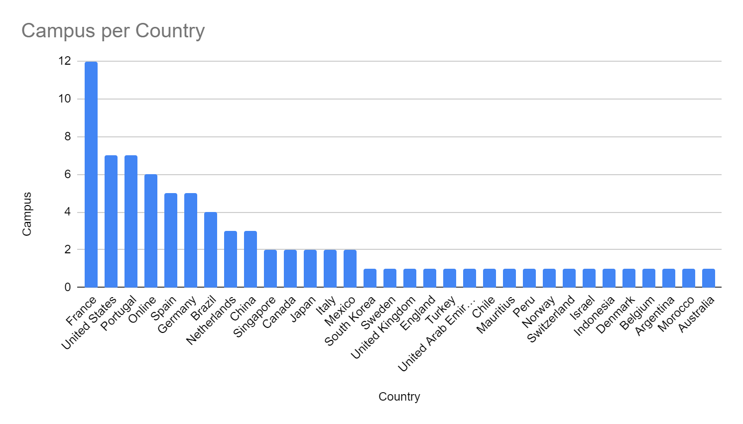
Analysis
Does country have to do with the amount of reviews?
Notes:
F

Slide 9
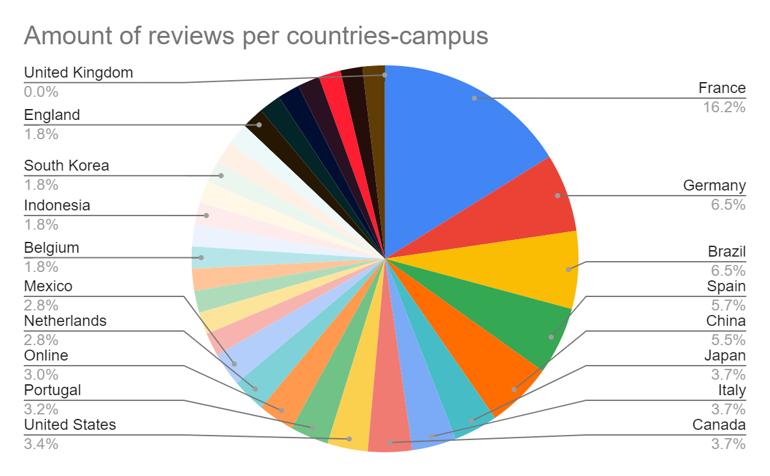
Analysis
Does country have to do with the amount of reviews?
Notes:
F

Slide 10
Analysis
Does online-course influence the rating?

Slide 11
Analysis
Rating | Badge
4.80 | Verified Outcomes
4.77 | Flexible Classes
4.77 | Available Online
4.58 | Job Guarantee
Does online-course influence the rating?
Notes:
F

Slide 12
Analysis
Rating | Available Online? | School
4.59 | Available Online | app-academy
4.80 | Available Online | ironhack
4.99 | Available Online | la-capsule
4.93 | Available Online | le-wagon
4.82 | Available Online | metis
4.73 | Available Online | practicum-by-yandex
4.76 | Available Online | react-graphql-academy
4.56 | Available Online | springboard
Does online-course influence the rating?
Notes:
F

Slide 13
Analysis summary
Does the amount of campus have to do with the user rating?
The amount of campuses doesn’t seem to be a criteria for student to choose a bootcamp
Does country have to do with the amount of reviews?
US odd amount of reviews
Does online-course influence the rating?
No possible correlation found
Notes:
F

Slide 14
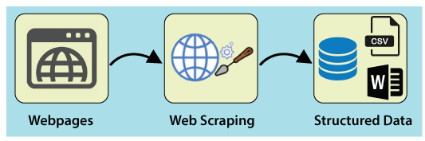


Improvements to make the process durable
- Future adaptations
To get new data, how will the data model behave?
Python code when executed perform the next actions :
Scrap the new schools id
Clean the data to be inserted into the database
Use SQL queries to update the database.
If new schools enter the market, how it would update?
Running the python program again will update the database :
- In the computer memory
- In the Cloud
Notes:
G

Slide 15
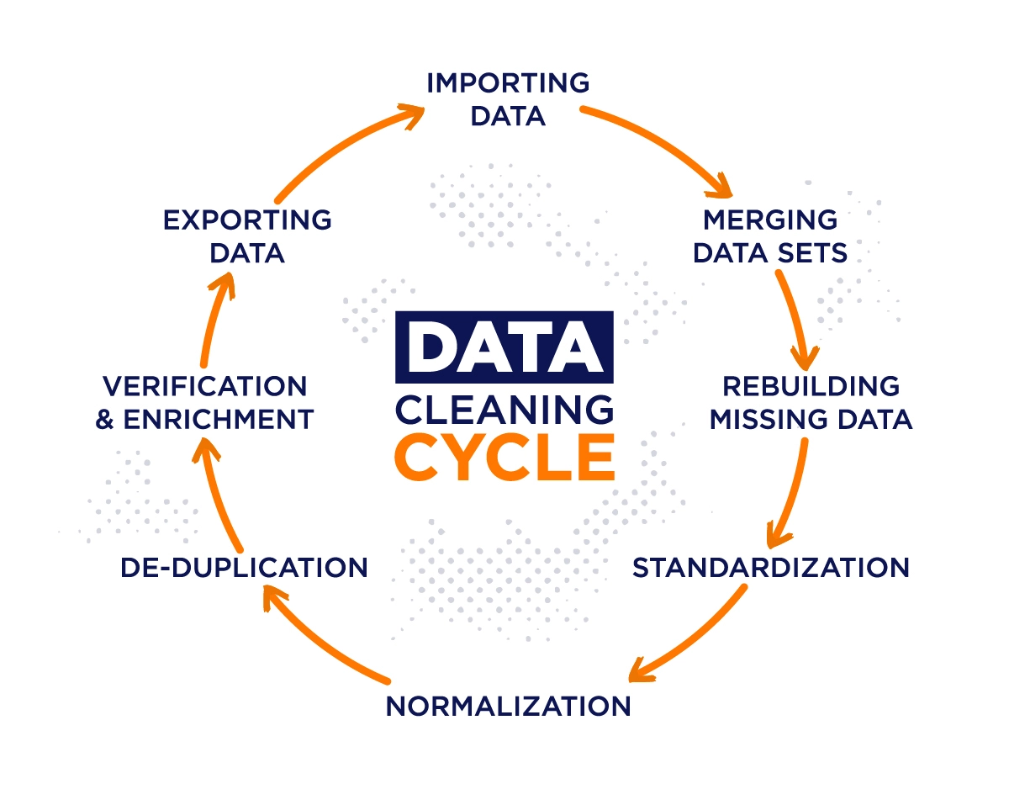
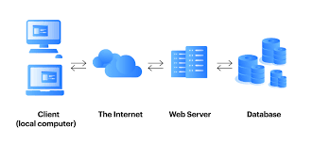
How would our analysts access this data in the future? (cloud deployment)
-Access a cloud database where new updates will be deployed
To add new analysis to our data model, what tables will we need to clean?
-Based on the goal of the analysis tables without meaning for the analyse
[GP1]
Notes:
G

Slide 16

Can we merge any tables with outside data?
-An API could be used to get the json file with info. about the cities population and based on cities id, merge with the tables of the project database
GeoDB Cities API
The GeoDB REST API offers global city and region data. API operations include determining the distance between cities, finding nearby cities, and support for city autocomplete as well as retrieval of city details, countries, country details, region details, currencies, locales, and time-zones.
Notes:
G

Slide 17
Thank you!

